Slide 1

FRC 4131
The Iron Patriots
2015 Design and Branding

Slide 2
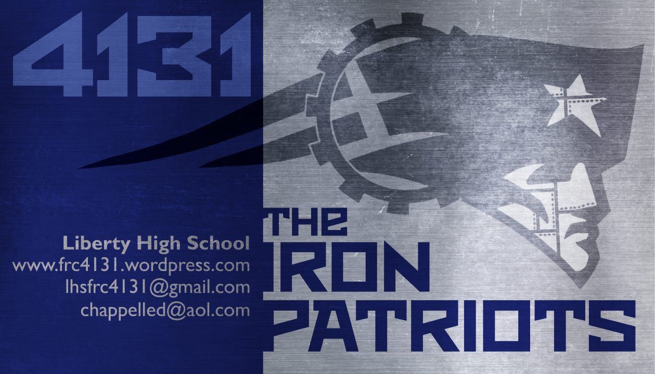
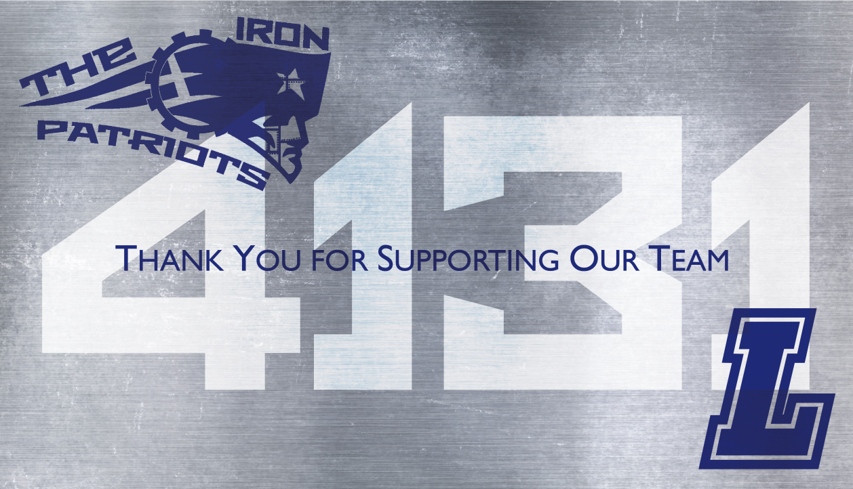

Slide 3


